Slide 1
WELCOME
To
Saline Water Intrusion
in Coastal Aquifer
Dr, Raman Kumar Biswas, Associate Professor, Dept of DRE, PSTU.
Department of Disaster Resilience and Engineering

Slide 2
Content
Introduction
Relation between Fresh Water and Seawater/ Ghyben-Herzberg Principle
Identification of Seawater Intrusion
Mitigation Measures

Slide 3
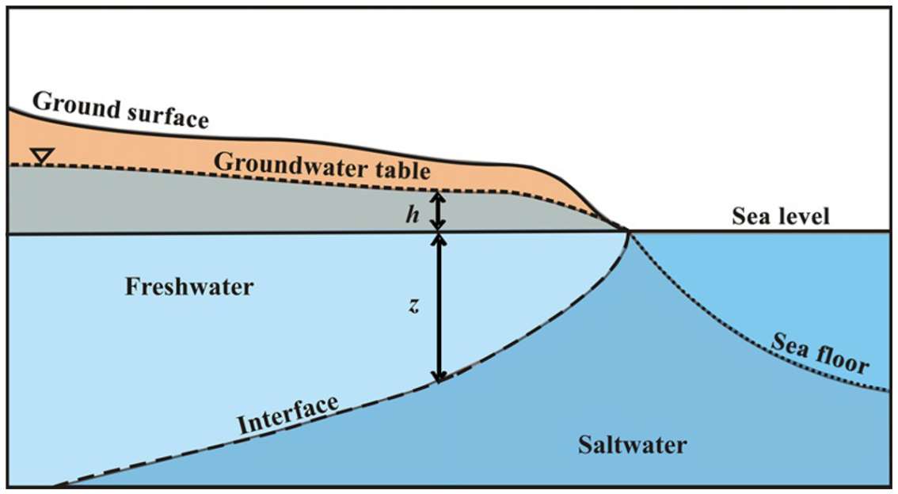
Introduction
1% of Seawater (250mg/L Chloride)
can contaminate the fresh water
How Sea water intrusion occurred?
Aquifer, Confined and Unconfined what is that?
Fig. Copyright at Manivannan Vengadesan Department of Geology, Anna University.

Slide 4
Relation between Fresh Water and Seawater/ Ghyben-Herzberg Principle
Ghyben-Herzberg Principle
Fig. Copyright at Manivannan Vengadesan Department of Geology, Anna University.

Slide 5
Identification of Seawater Intrusion
The common Methods are:
-Ground water head
-Geophysical Methods
Geochemical Methods
-Isotopic Methods

Slide 6
Identification of Seawater Intrusion
The common Methods are:
-Ground water head

Slide 7
Mitigation Measures
The different methods for mitigating seawater intrusion are discussed in this section.
-Reduction in Pumping
Rearranging of Pumping Wells
Increasing Groundwater Recharge
Injection Wells
Saltwater Pumping Wells
Subsurface Barrier
Go next

Slide 8
Mitigation Measures
-Reduction in Pumping
This figure was uploaded by Qi Li

Slide 9
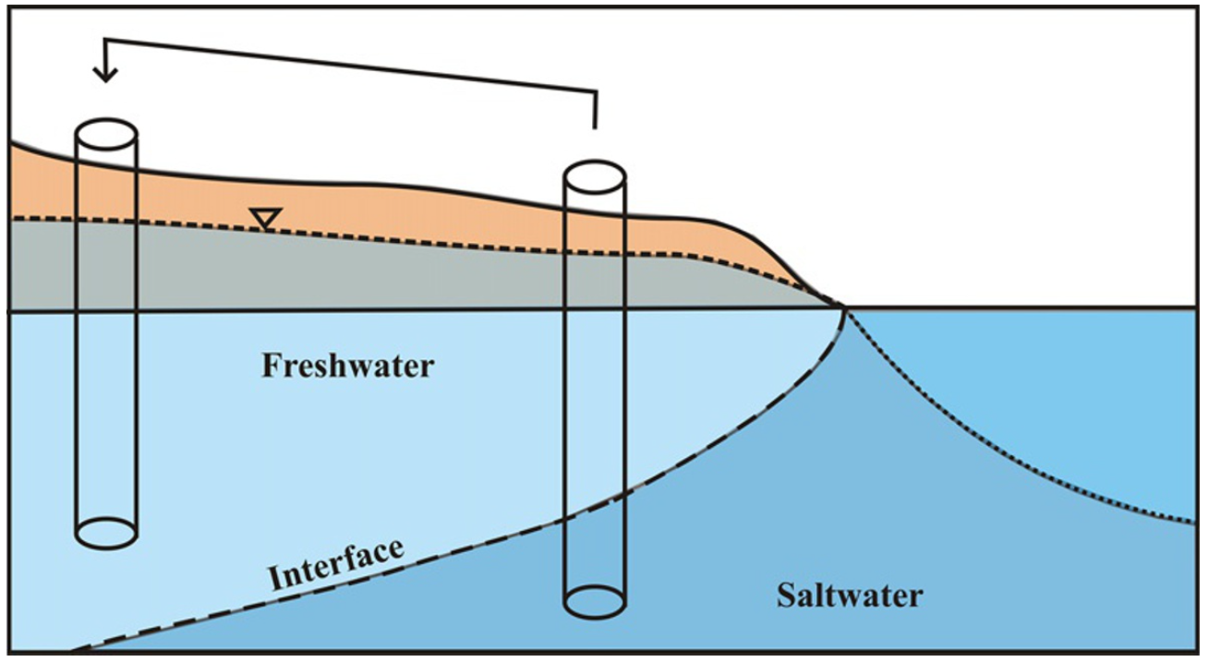
Mitigation Measures
Fig. Copyright at Manivannan Vengadesan Department of Geology, Anna University.
Rearranging of Pumping Wells

Slide 10
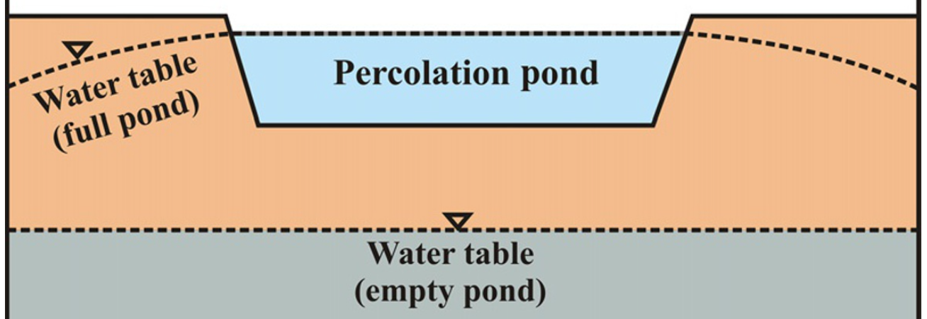
Mitigation Measures
Fig. Copyright at Manivannan Vengadesan Department of Geology, Anna University.
Increasing Groundwater Recharge

Slide 11
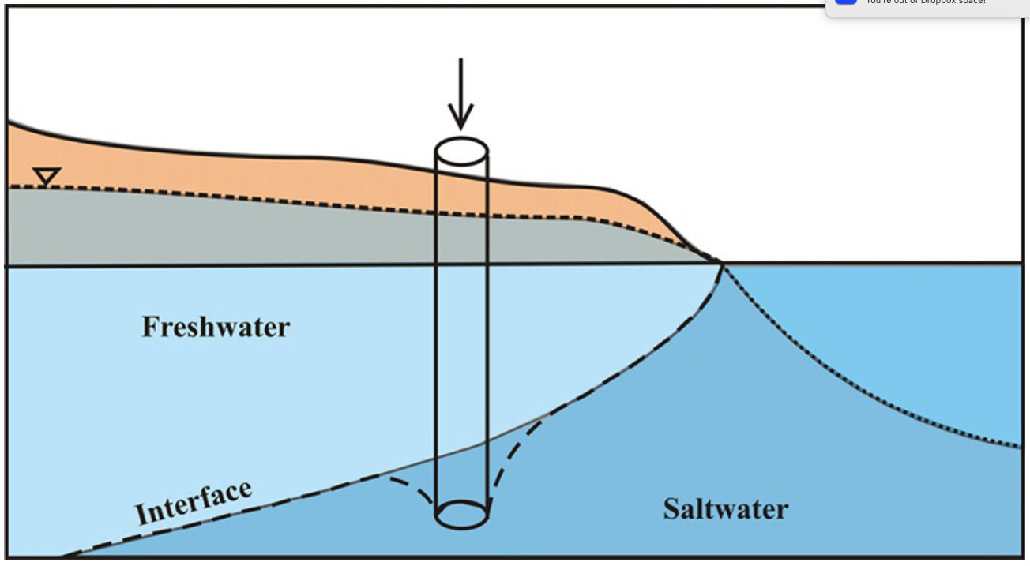
Mitigation Measures
Injection Wells
Fig. Copyright at Manivannan Vengadesan Department of Geology, Anna University.

Slide 12
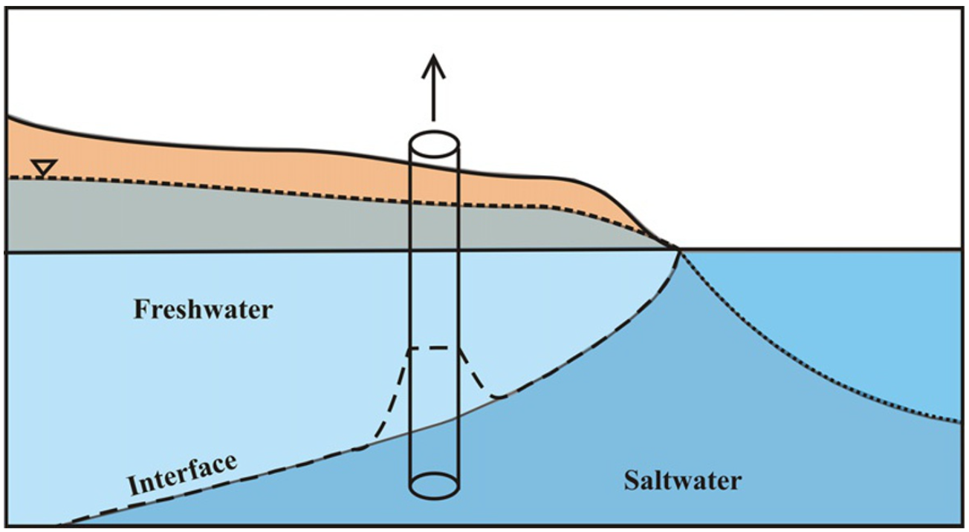
Mitigation Measures
Fig. Copyright at Manivannan Vengadesan Department of Geology, Anna University.
Saltwater Pumping Wells

Slide 13
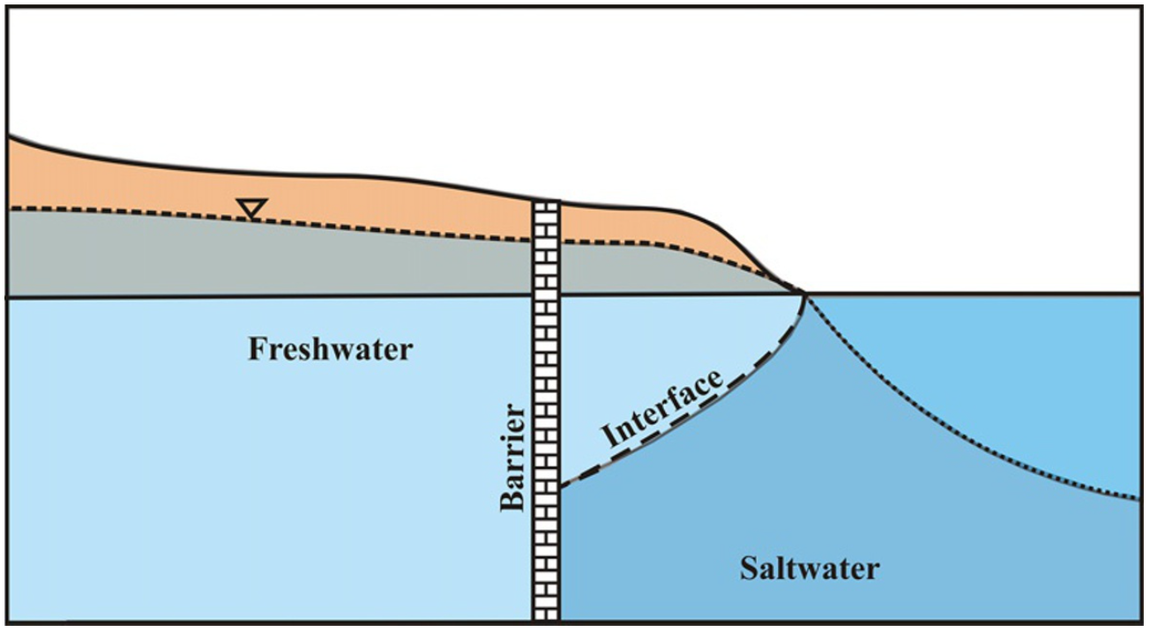
Mitigation Measures
Fig. Copyright at Manivannan Vengadesan Department of Geology, Anna University.
Subsurface Barrier

Slide 14
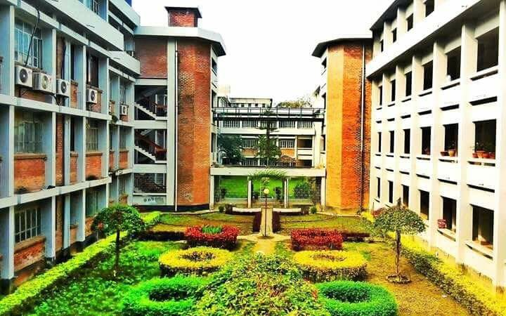
Thank you very much

